Slide 1
Class 4
Advanced Collisions and Physics

Slide 2
Collisions
So far, we have had to write a new function every time we wanted to detect collisions between a new pair of shapes
In this class, we will discuss a general method for detecting collisions that works for all convex shapes called the GJK algorithm
We can easily replace our ellipsoid/triangle collisions with GJK collisions
But first…

Slide 3
Class 4
Rotations

Slide 4
Rotations
Rotations can be represented by Euler angles (i.e. roll, pitch, yaw), rotation matrices, or quaternions
Useful fact: any arbitrary orientation can be achieved by a single rotation about some axis by some angle

Slide 5


Euler Angles
When we talk about Euler angles, we need to define an order of how the angles are set
We also need to say whether each angle in the sequence is measured in the object’s transformed coordinate frame after each step (intrinsic), or the world coordinate frame (extrinsic angles)
Here, we have a sphere first rotating $θ_{1}$ about the z axis (up), then rotating $θ_{2}$ the x axis in its transformed coordinate frame, then rotating $θ_{3}$ the z axis in its transformed coordinate frame
These are intrinsic rotations
If the sphere first rotated $θ_{3}$ about the world z axis, then rotated $θ_{2}$ about the world x axis, and then rotated $θ_{1}$ about the world z axis, we would have extrinsic rotations
We would also have the same orientation as we did with the intrinsic rotations described to the left!

Slide 6

Rotation Matrices
Rotation matrices are 3x3 orthogonal matrices with determinant 1
This means that the columns of the matrix form an orthonormal basis of $R^{3}$ (a set of pairwise orthogonal and normalized vectors that span $R^{3}$)
A rotation matrix says “x-axis, turn into my first column”, “y-axis, turn into my second column”, and “z-axis, turn into my third column”

Slide 7
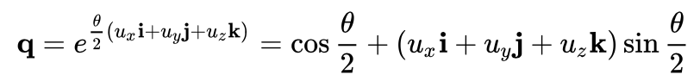

Quaternions
Quaternions are a confusing subject, but it is helpful to know that there is a formula that takes in an axis of rotation $u$ and an angle $θ$ and gives you the quaternion corresponding to that rotation

Slide 8
Rotations
You will need to convert between rotation matrices and Euler angles in order to implement advanced collisions (if your transform component uses Euler angles)

Slide 9
Class 4
GJK (Gilbert-Johnson-Keerthi) Algorithm

Slide 10
Support Functions
GJK Algorithm

Slide 11
Convex Shapes
A convex shape satisfies the requirement that the line segment connecting any point to any other point inside the shape exists entirely inside the shape
Convex
Not Convex

Slide 12

Support Functions
Shape
f(v) (red point)
v
We can define a support function for a convex shape
A support function takes in a direction and then returns the point on the shape farthest in that direction
More precisely, given a direction $v$, the support function $f$ of a shape $s$ is $f\left(v\right)=\max_{\left\{p∈s\right\}}v⋅p$
Notice that the support function for the square always returns a corner
In the middle example, the vector is pointing slightly to the right, so the bottom right corner of the square maximizes the dot product

Slide 13

More Support Function Examples
Given a direction $v$, the support function $f$ of a shape $s$ is $f\left(v\right)=\max_{\left\{p∈s\right\}}v⋅p$
v
Shape
v
f(v) (red point)
Note the first example
The point returned is not necessary the exact point that the arrow is pointing to
Instead, the point returned is the point that maximizes the dot product

Slide 14
Support Functions Takeaway
In a very broad sense, you can think of a support function as a function that takes in a direction and returns a point on the boundary of the shape farthest in that direction

Slide 15
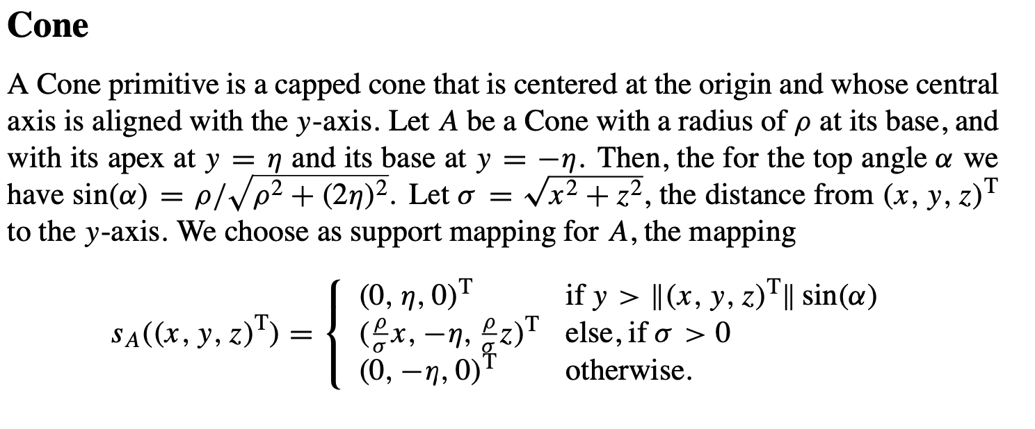
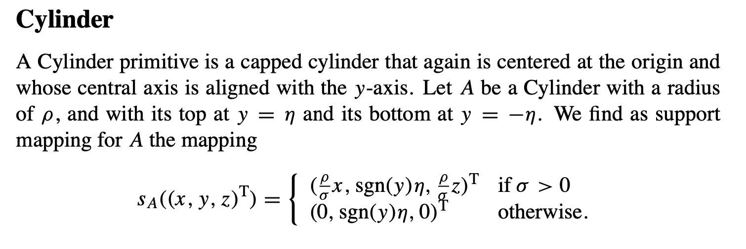
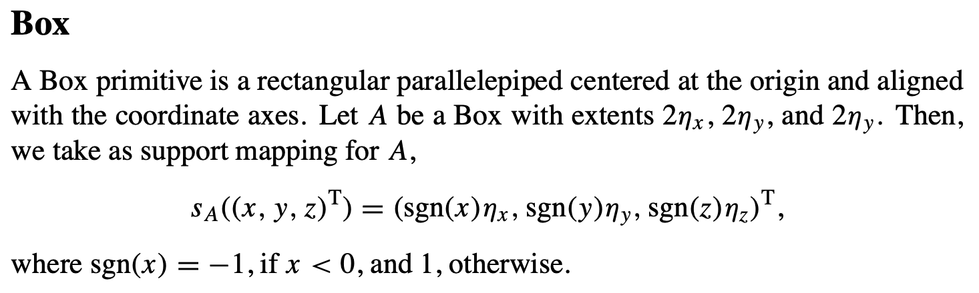
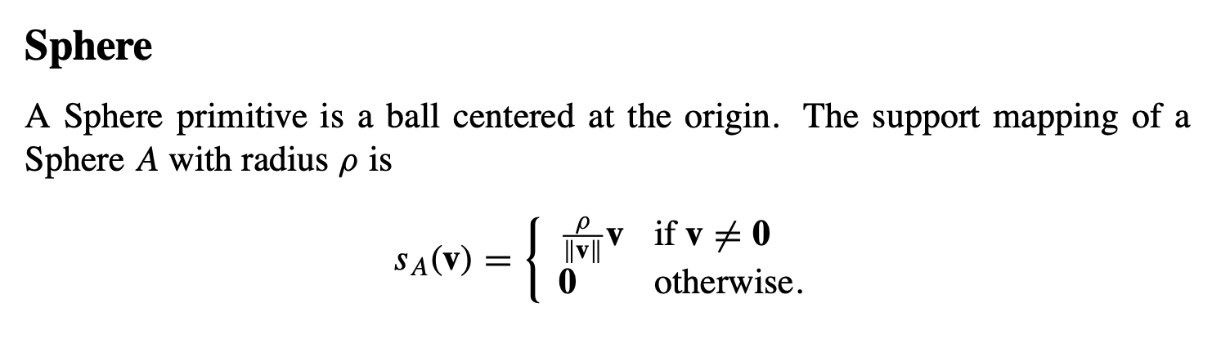
Support Functions for 3D Shapes
From A Fast and Robust GJK Implementation for Collision Detection of Convex Objects
GINO VAN DEN BERGEN

Slide 16
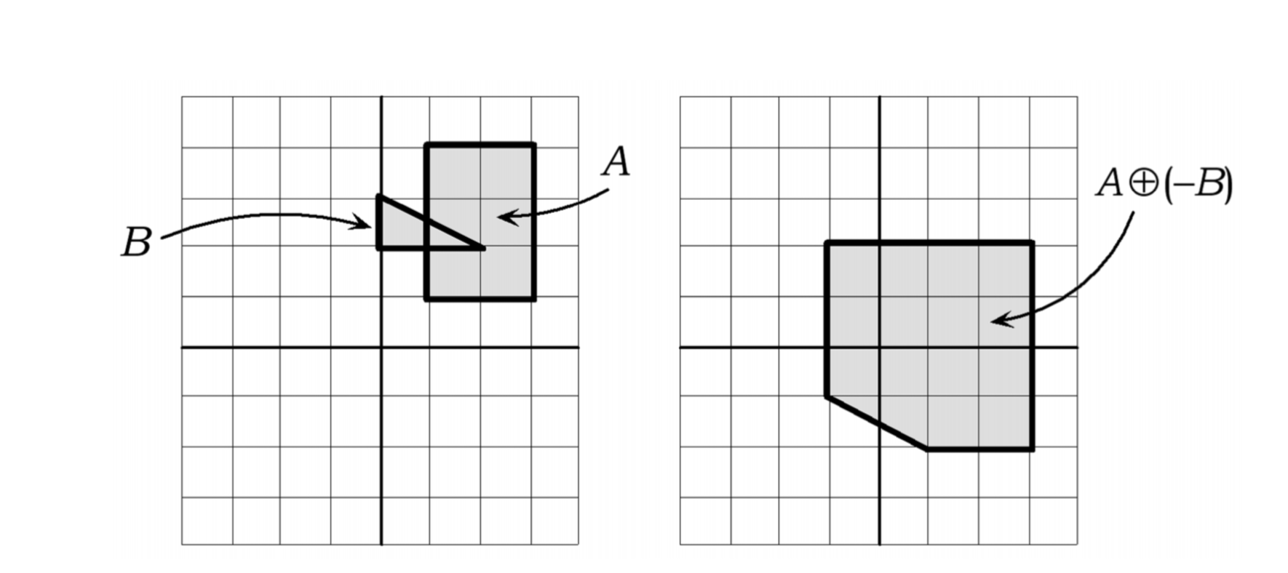
Minkowski Difference
The Minkowski difference of shapes A and B is the set of points that are the difference of a point in A and a point in B
In other words, if we subtract every point in B from every point in A we get the Minkowski difference

Slide 17
Minkowski Difference
A and B are colliding if and only if the Minkowski difference contains the origin
Think about it this way: if A and B are colliding then they will overlap at some point in space
The Minkowski difference value resulting from this overlap is the origin
We can use this fact to determine whether two shapes are colliding

Slide 18

Minkowski Difference and Support Functions
It turns out that the Minkowski difference of two convex shapes is also convex
This means we can define the support function of the Minkowski difference!
The support function $f_{A−B}$ of the Minkowski difference of shapes $A$ and $B$ with support functions $f_{A}$ and $f_{B}$ is $f_{A−B}\left(v\right)=f_{A}\left(v\right)−f_{B}(−v)$
This identity requires a small proof that we will omit

Slide 19
The algorithm
GJK Algorithm

Slide 20

GJK Algorithm
To figure out whether two shapes are colliding in 3D, we answer the question: “is the origin in the Minkowski difference?”
To answer this question, we will try to create a simplex that contains the origin
A simplex is a generalization of a triangle to arbitrary dimensions
The 0-dimensional simplex is a point, the 1-dimensional simplex is a line, the 2-dimensional simplex is a triangle, and the 3-dimensional simplex is a tetrahedron
The vertices of the simplex we are searching for are points returned by the support function of the Minkowski difference

Slide 21
GJK Algorithm
To be more concrete, we have a collision if we can create a simplex consisting of vertices returned from the support function of the Minkowski difference satisfying one of the following:
a 0-simplex (point) that contains the origin (the simplex itself is the origin)
a 1-simplex (line segment) that contains the origin (the origin is on the line segment)
a 2-simplex (triangle) that contains the origin (the origin exists on the triangle face)
A 3-simplex (tetrahedron) that contains the origin (the origin is inside the volume of the tetrahedron

Slide 22
GJK Algorithm Pseudocode
A = the newest vertex in the simplex
D = the next direction we plug into the Minkowski difference support function
pair<bool, simplex> gjk(support_func):
S = support_func(arbitrary_direction)
simplex = [S]
D = -S
while True:
A = support_func(D)
if dot(A, D) < 0: return (false, [])
simplex.append(A)
if do_simplex(simplex, D): return (simplex, D)
Pseudocode from “Implementing GJK - 2006” by Casey Muratori
do_simplex updates simplex and D

Slide 23
GJK Algorithm Pseudocode
pair<bool, simplex> gjk(support_func):
S = support_func(arbitrary_direction)
simplex = [S]
D = -S
while True:
A = support_func(D)
if dot(A, D) < 0: return (false, [])
simplex.append(A)
if do_simplex(simplex, D): return (simplex, D)
We first find an arbitrary point in the Minkowski difference (S)
Next, we find the point (A) in the Minkowski difference farthest in the opposite direction of S
If dot(A, D) < 0, then we did not pass the origin when we walked from vertex S to vertex A
Pseudocode from “Implementing GJK - 2006” by Casey Muratori

Slide 24
GJK Algorithm Pseudocode
pair<bool, simplex> gjk(support_func):
S = support_func(arbitrary_direction)
simplex = [S]
D = -S
while True:
A = support_func(D)
if dot(A, D) < 0: return (false, [])
simplex.append(A)
if do_simplex(simplex, D): return (simplex, D)
We first find an arbitrary point in the Minkowski difference (S)
Next, we find the point (A) in the Minkowski difference farthest in the opposite direction of S
If dot(A, D) < 0, then we did not pass the origin when we walked from vertex S to vertex A
S
D
0
A
Vertex A did not pass the origin
Pseudocode from “Implementing GJK - 2006” by Casey Muratori

Slide 25
GJK Algorithm Pseudocode
pair<bool, simplex> gjk(support_func):
S = support_func(arbitrary_direction)
simplex = [S]
D = -S
while True:
A = support_func(D)
if dot(A, D) < 0: return (false, [])
simplex.append(A)
if do_simplex(simplex, D): return (simplex, D)
We first find an arbitrary point in the Minkowski difference (S)
Next, we find the point (A) in the Minkowski difference farthest in the opposite direction of S
If dot(A, D) < 0, then we did not pass the origin when we walked from vertex S to vertex A
S
D
A
0
Vertex A passed the origin
Pseudocode from “Implementing GJK - 2006” by Casey Muratori

Slide 26
GJK Algorithm Pseudocode
pair<bool, simplex> gjk(support_func):
S = support_func(arbitrary_direction)
simplex = [S]
D = -S
while True:
A = support_func(D)
if dot(A, D) < 0: return (false, [])
simplex.append(A)
if do_simplex(simplex, D): return (simplex, D)
We first find an arbitrary point in the Minkowski difference (S)
Next, we find the point (A) in the Minkowski difference farthest in the opposite direction of S
If dot(A, D) < 0, then we did not pass the origin when we walked from vertex S to vertex A
The Minkowski difference is convex, so if we did not pass the origin when we walked from vertex S to vertex A, then we know that there is no collision
Pseudocode from “Implementing GJK - 2006” by Casey Muratori

Slide 27
GJK Algorithm Pseudocode
pair<bool, simplex> gjk(support_func):
S = support_func(arbitrary_direction)
simplex = [S]
D = -S
while True:
A = support_func(D)
if dot(A, D) < 0: return (false, [])
simplex.append(A)
if do_simplex(simplex, D): return (simplex, D)
If we succeeded in passing the origin, then we add vertex A to the simplex
Next, we run the do_simplex function, which decides if we are done. If not, the function finds the next direction D that we should plug into the support function. The support function will then give us the next vertex we will add to the simplex.
Pseudocode from “Implementing GJK - 2006” by Casey Muratori

Slide 28
GJK Algorithm Pseudocode
pair<bool, simplex> gjk(support_func):
S = support_func(arbitrary_direction)
simplex = [S]
D = -S
while True:
A = support_func(D)
if dot(A, D) < 0: return (false, [])
simplex.append(A)
if do_simplex(simplex, D): return (simplex, D)
We can see that the main GJK algorithm is not too complicated
The function do_simplex is doing most of the heavy lifting here
do_simplex does the following:
Decide if the current simplex contains the origin (if so, GJK returns true and the simplex)
If the current simplex does not contain the origin, find the optimal direction to search and update simplex and D accordingly
Pseudocode from “Implementing GJK - 2006” by Casey Muratori

Slide 29
GJK Algorithm Pseudocode
pair<bool, simplex> gjk(support_func):
S = support_func(arbitrary_direction)
simplex = [S]
D = -S
while True:
A = support_func(D)
if dot(A, D) < 0: return (false, [])
simplex.append(A)
if do_simplex(simplex, D): return (simplex, D)
bool do_simplex(simplex, D):
if contains_origin(simplex): return true
return handle_simplex(simplex, D)
Pseudocode from “Implementing GJK - 2006” by Casey Muratori

Slide 30
GJK Algorithm Pseudocode
When we call handle_simplex, the simplex will have 2, 3, or 4 vertices
We need to figure out the optimal way to change the simplex in each case
The optimal way to change the simplex will capture the origin in a simplex in the minimum number of iterations
pair<bool, simplex> gjk(support_func):
S = support_func(arbitrary_direction)
simplex = [S]
D = -S
while True:
A = support_func(D)
if dot(A, D) < 0: return (false, [])
simplex.append(A)
if do_simplex(simplex, D): return (simplex, D)
bool do_simplex(simplex, D):
if contains_origin(simplex): return true
return handle_simplex(simplex, D)
Pseudocode from “Implementing GJK - 2006” by Casey Muratori

Slide 31
Updating the Simplex
The content here is adapted from “Implementing GJK -2006”, a video by Casey Muratori
This video points out the important insight that the position of the vertex that was last added to the simplex gives us hints about which direction we should plug into the Minkowski support function in the next iteration (to get the next vertex of the simplex)
In the following slides, the vertex that was last added to the simplex will be called A
Pseudocode from “Implementing GJK - 2006” by Casey Muratori

Slide 32
Handling the 1-Simplex (Line)
S
Newest Vertex
Remember that every vertex in the simplex is a point on the boundary of the Minkowski difference
We need to find a new direction to plug into the support function of the Minkowski difference
A

Slide 33
Handling the 1-Simplex (Line)
S
Newest Vertex
How did the simplex become a line?
A

Slide 34
Handling the 1-Simplex (Line)
S
Newest Vertex
Let’s look at the pseudocode again…
pair<bool, simplex> gjk(support_func):
S = support_func(arbitrary_direction)
simplex = [S]
D = -S
while True:
A = support_func(D)
if dot(A, D) < 0: return (false, [])
simplex.append(A)
if do_simplex(simplex, D): return (simplex, D)
A

Slide 35
Handling the 1-Simplex (Line)
S
Newest Vertex
First, we add some point (S) to simplex
pair<bool, simplex> gjk(support_func):
S = support_func(arbitrary_direction)
simplex = [S]
D = -S
while True:
A = support_func(D)
if dot(A, D) < 0: return (false, [])
simplex.append(A)
if do_simplex(simplex, D): return (simplex, D)
A

Slide 36
Handling the 1-Simplex (Line)
Then, we plug –S into the support function
Remember that we only got to this point in the algorithm because we passed the origin when we walked from S to A
S
Newest Vertex
pair<bool, simplex> gjk(support_func):
S = support_func(arbitrary_direction)
simplex = [S]
D = -S
while True:
A = support_func(D)
if dot(A, D) < 0: return (false, [])
simplex.append(A)
if do_simplex(simplex, D): return (simplex, D)
A

Slide 37
Handling the 1-Simplex (Line)
Since we know that we passed the origin, we know that the origin exists somewhere in the orange area between S and A (extending out to infinity)
The origin cannot be behind S or behind A
S
Newest Vertex
pair<bool, simplex> gjk(support_func):
S = support_func(arbitrary_direction)
simplex = [S]
D = -S
while True:
A = support_func(D)
if dot(A, D) < 0: return (false, [])
simplex.append(A)
if do_simplex(simplex, D): return (simplex, D)
A

Slide 38
Handling the 1-Simplex (Line)
So, the new direction D is the vector perpendicular to the line segment SA in the direction of the origin!
We don’t need to adjust the simplex at all in this case before adding support_function(D) to the
The 1-simplex case is solved!
S
Newest Vertex
A

Slide 39
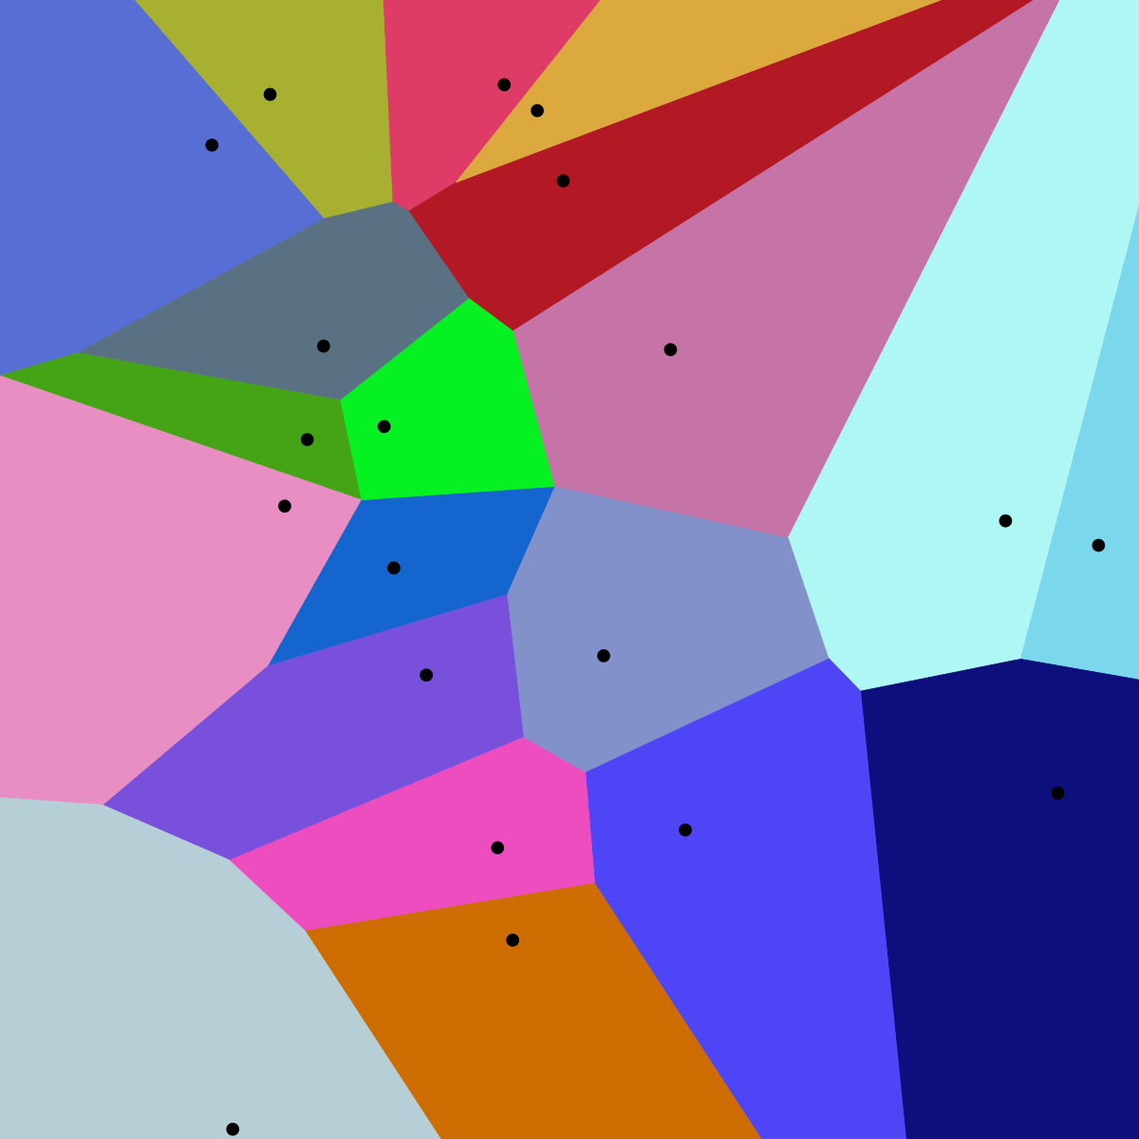
Aside: Voronoi Diagrams
A Voronoi diagram shows a partition of the plane where the ”Voronoi region” of a seed s (a black dot in the figure) is the set of points that are closer to s than any other seed
It is useful to think about this type of diagram when dealing with the 2-simplex case

Slide 40
Handling the 2-Simplex (Triangle)
There are 8 (Voronoi) regions where we might want to search for the origin
B
C
Newest Vertex
A

Slide 41
Handling the 2-Simplex (Triangle)
There are 8 (Voronoi) regions where we might want to search for the origin
B
The region closest to the vertex C
C
Newest Vertex
A

Slide 42
Handling the 2-Simplex (Triangle)
There are 8 (Voronoi) regions where we might want to search for the origin
B
C
Newest Vertex
The region closest to the line CA
A

Slide 43
Handling the 2-Simplex (Triangle)
There are 8 (Voronoi) regions where we might want to search for the origin
B
C
Newest Vertex
A
The region closest to the vertex A

Slide 44
Handling the 2-Simplex (Triangle)
There are 8 (Voronoi) regions where we might want to search for the origin
B
The region closest to the line AB
C
Newest Vertex
A

Slide 45
Handling the 2-Simplex (Triangle)
The region closest to the vertex B
There are 8 (Voronoi) regions where we might want to search for the origin
B
C
Newest Vertex
A

Slide 46
Handling the 2-Simplex (Triangle)
There are 8 (Voronoi) regions where we might want to search for the origin
B
The region closest to the line CB
C
Newest Vertex
A

Slide 47
Handling the 2-Simplex (Triangle)
There are 8 (Voronoi) regions where we might want to search for the origin
B
C
The region above the triangle
Newest Vertex
A

Slide 48
Handling the 2-Simplex (Triangle)
There are 8 (Voronoi) regions where we might want to search for the origin
B
C
The region below the triangle
Newest Vertex
A

Slide 49
Handling the 2-Simplex (Triangle)
There are 8 (Voronoi) regions where we might want to search for the origin
Keep in mind that, if this triangle were on the XY plane, then these regions would extend straight forward and backward in the z-direction
B
S
Newest Vertex
A

Slide 50
Handling the 2-Simplex (Triangle)
Our task is to find the region containing the origin
When we find that region, we will send our new direction D into that region!
B
C
Newest Vertex
A

Slide 51
Handling the 2-Simplex (Triangle)
But we don’t have to check every region!
We have ruled out some of these regions in previous iterations!
B
C
Newest Vertex
A

Slide 52
Handling the 2-Simplex (Triangle)
Remember that the newest vertex is A
When our simplex was CB, we decided the origin was in the direction of A
Therefore, the CB region does not contain the origin
B
C
Newest Vertex
A

Slide 53
Handling the 2-Simplex (Triangle)
B
C
Newest Vertex
A

Slide 54
Handling the 2-Simplex (Triangle)
B
The C and B regions also do not contain the origin!
Consider the 1-simplex case to see why!
C
Newest Vertex
A

Slide 55
Handling the 2-Simplex (Triangle)
So, we have 5 regions to check: CA, A, AB, above the triangle, and below the triangle!
We use a bunch of dot and cross products to decide which region the origin is in
B
C
Newest Vertex
A

Slide 56
2-Simplex Pseudocode
simplex2_case(simplex, D):
A = simplex[2] // newest vertex in the simplex
B = simplex[1]
C = simplex[0]
// let’s arbitrarily say this normal points “above” the triangle (in the previous slides, this normal would point at us)
// this way, we don’t have to maintain a winding order
normal = cross(B-A,C-A)
if dot(cross(normal, C-A), -A) > 0: // true if origin is in CA region or A region
if dot(C-A, -A) > 0: // true if origin is in CA region
simplex = [C,A]
D = cross(cross(C-A, -A), C-A)
return
else: // executes if origin is in A region
simplex = [A]
D = -A
return
else:
if dot(cross(B-A, normal), -A) > 0: // true if the origin is in BA region or A region
if dot(B-A, -A) > 0: // true if origin is in BA region
simplex = [B,A]
D = cross(cross(B-A, -A), B-A)
return
else: // executes if origin is in A region
simplex = [A]
D = -A
return
else: // executes if origin is above or below the triangle
if dot(normal, -A) > 0: // true if origin is above triangle
simplex = [A,B,C]
D = normal
return
else: // executes if origin is below triangle
simplex = [A,B,C]
D = -normal
return
Pseudocode from “Implementing GJK - 2006” by Casey Muratori

Slide 57
Handling the 3-Simplex
Remember that we want a simplex with at most 4 vertices!
When we have a 3-simplex (tetrahedron), we just reduce the problem back to the 2-simplex case
Given a tetrahedron where vertex A is the newest vertex, we calculate which of the planes of faces ABC, ABD, and ACD is closest to the origin
Make sure the closest plane is actually facing the origin
Then we just run our 2-simplex code on that face!

Slide 58
Verifying the Simplex
We know we are done running GJK if we fail to pass the origin or if the simplex contains the origin
A 2-simplex contains the origin if the origin exists on the face of the triangle
We should first verify whether the origin exists in the plane of the triangle
If the origin exists in the plane of the triangle, then the simplex contains the origin if, when we take any edge of the simplex, the origin is on the same side of the edge as the vertex of the simplex opposite the edge
A 3-simplex contains the origin if, when we take any face of the simplex, the origin is on the same side of the face as the vertex of the simplex opposite the face

Slide 59
Evaluating the Minkowski Difference Support function
The Minkowksi difference is in world space
The support functions for our objects are in object space
The direction D is in world space
Then how do we calculate the Minkowski difference?

Slide 60
Evaluating the Minkowski Difference Support function
We have objects 1 and 2
Convert D into the object space of objects 1 and 2 to get D₁ and D₂
Evaluate the support function of object 1 using D₁ and evaluate the support function of object 2 using D₂ to get points p₁ and p₂
Convert p₁ and p₂ to world space to get P₁ and P₂ and then return the difference of P₁ and P₂

Slide 61
Are we done yet?
So, we have everything we need to implement the GJK algorithm!
But the GJK algorithm gives us a boolean indicating whether there was collision (and a simplex containing the origin if there was a collision)
Don’t we want a minimum translation vector (MTV)?
We need to know how to resolve the collision once we know it is occurring
Introducing…

Slide 62
Class 4
Expanding Polytope Algorithm (EPA)

Slide 63
Expanding Polytope Algorithm
If there was a collision, then we must resolve it (i.e. stop the objects from intersecting)
We get a simplex containing the origin from the GJK algorithm if there was a collision
It turns out that the minimum translation vector (MTV) is the vector connecting the origin to the point on the Minkowski difference closest to the origin
In other words, if point A is the point on the Minkowski difference closest to the origin, then the MTV is A!
The goal of the Expanding Polytope Algorithm is to find the point on the Minkowski difference closest to the origin, so that we can use the MTV
Note that it does not make sense to use the Expanding Polytope Algorithm if there was not a collision, because in that case there is no need for an MTV
In fact, the Expanding Polytope Algorithm (EPA) only works when we have a simplex of points in the Minkowski difference and this simplex contains the origin

Slide 64
Expanding Polytope Algorithm
Let the blue shape be the Minkowski difference, the orange shape be the simplex, and the red point be the origin

Slide 65
Expanding Polytope Algorithm
We can see that the MTV is the green vector below

Slide 66
Expanding Polytope Algorithm
We can see that the MTV is the green vector below

Slide 67
Expanding Polytope Algorithm
EPA iteratively expands the simplex, adding more points on the boundary of the Minkowski difference to find the MTV

Slide 68


Expanding Polytope Algorithm
To find the next point on the boundary of the Minkowski difference, we find the point on the boundary of the simplex (which we will now call a polytope) closest to the origin (the purple point)
At iteration $i$, call this point $v_{i}$
$$v_{0}$$

Slide 69


Expanding Polytope Algorithm
We plug $v_{i}$ into the support function of the Minkowski difference to get $w_{i}$
We terminate the algorithm and return $v_{i}$ when the projection of $w_{i}$ onto $v_{i}$ is equal to $v_{i}$ (within some tolerance)
When the projection of $w_{i}$ onto $v_{i}$ is equal to $v_{i}$, we know that the $v_{i}$ is on the boundary of the Minkowski difference
In this iteration, we see that this termination condition is not met, so we add $w_{i}$ to the polytope by splitting the edge/face that $v_{0}$ belonged to
$$w_{0}$$
$$v_{0}$$

Slide 70
Expanding Polytope Algorithm
$$w_{0}$$

Slide 71


Expanding Polytope Algorithm
Next, we carry out another iteration
We find the point on the boundary of the polytope closest to the origin ($v_{1}$)
$$v_{1}$$

Slide 72


Expanding Polytope Algorithm
Then, we plug $v_{1}$ into the support function of the Minkowski difference to get $w_{1}$
The projection of $w_{1}$ onto $v_{1}$ is not equal to $v_{1}$, so we add $w_{1}$ to the polytope by splitting the edge $v_{1}$ belonged to
$$w_{1}$$
$$v_{1}$$

Slide 73


Expanding Polytope Algorithm
We find the point on the polytope closest to the origin ($v_{2}$)
$$v_{2}$$

Slide 74


Expanding Polytope Algorithm
Then we plug $v_{2}$ into the support function of the Minkowski difference to get $w_{2}$
The projection of of $w_{2}$ onto $v_{2}$ is equal to $v_{2}$, so we return $v_{2}$, which is the MTV!
$$v_{2}$$
$w_{2}$

Slide 75
EPA Pseudocode
EPA(simplex):
polytope = simplex
while (true)
face = getClosestFaceToOrigin(polytope)
v = projectionOfOriginOnFace(face)
w = minkowskiSupport(v)
if projection(w,v) == v:
return v
else
simplex.add(w)

Slide 76
Extra Details
We have looked at an EPA example in 2D
There are a few details that we need to consider when we transition to 3D

Slide 77
Representing the Polytope
We have looked at an EPA example in 2D
There are a few details that we need to consider when we transition to 3D
First, the polytope in 3D is defined as a set of triangles forming a convex 3D shape
We can represent the polytope like a mesh, by having a list of vec3s defining the vertex positions, and a list of triplets of integers representing the faces

Slide 78
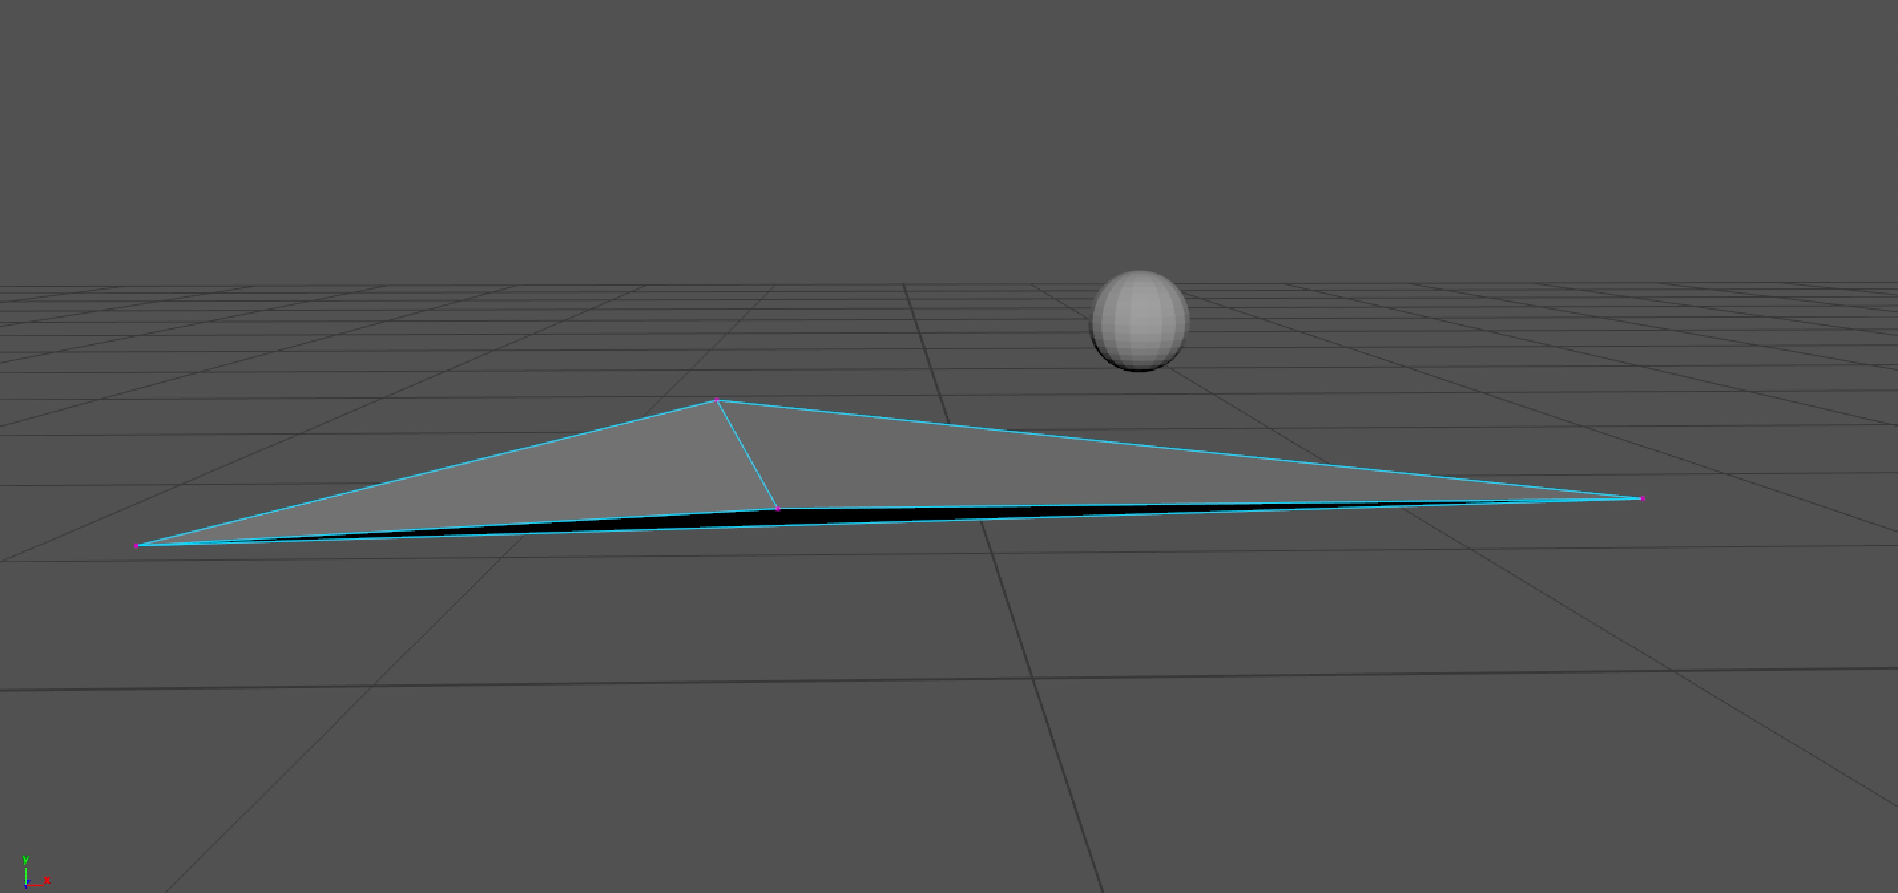

Expanding the Polytope in 3D
If we need to expand the polytope, we can’t just split the face containing $v_{i}$ into 3 faces that contain $w_{i}$
If we do this, we will get a non-convex shape, as shown in the video below (the sphere represents $w_{i}$)

Slide 79





Expanding the Polytope in 3D
To handle this problem, we need to make sure every face of the polytope that “sees” $w_{i}$ is changed so that face has $w_{i}$ as a vertex
A face with normal $n$ and a vertex $t$ “sees” $w_{i}$ if $(w_{i}−t)⋅n>0$
$$w_{i}$$
Here, the blue face ”sees” $w_{i}$
$$n$$
$$t$$

Slide 80


Expanding the Polytope in 3D
To handle this problem, we need to make sure every face of the polytope that “sees” $w_{i}$ is changed so that face has $w_{i}$ as a vertex
A face with normal $n$ and a vertex $t$ “sees” $w_{i}$ if $(w_{i}−t)⋅n>0$
Here, the blue face does not ”see” $w_{i}$
$$n$$
$$t$$
$$w_{i}$$

Slide 81
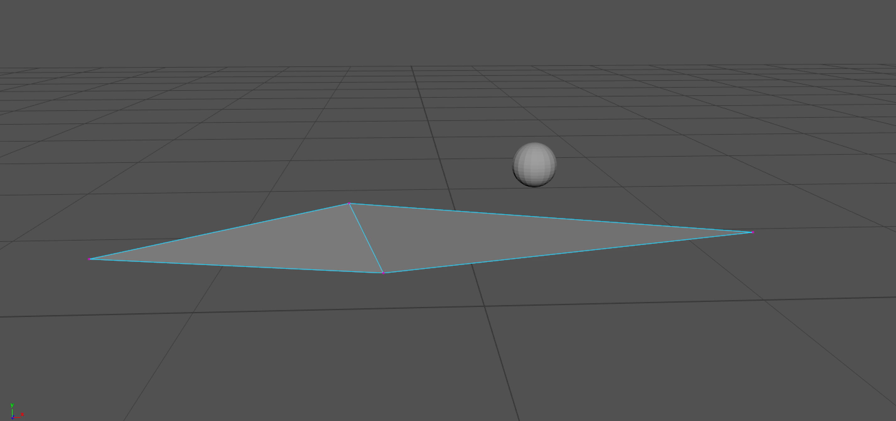
Expanding the Polytope in 3D
The video below provides a demonstration of this process

Slide 82
Expanding the Polytope in Pseudocode
edges = []
for face in polytope:
if face.sees(w):
polytope.remove(face)
for edge in face:
if edge in edges:
edges.remove(edge)
else:
edges.append(edge)
for edge in edges:
polytope.addTriangle(Triangle(edge.start, edge.end, w))
Pseudocode from GJK + Expanding Polytope Algorithm – Implementation and Visualization by Andrew Smith

Slide 83

Expanding the Polytope Pseudocode
The pseudocode says that any face that does not see $w_{i}$ will be in the new polytope
Any face that does see $w_{i}$ will be removed
For each edge of a face that sees $w_{i}$ but is not shared between two faces that see $w_{i}$ create a face using that edge and $w_{i}$
This process results in a convex polytope

Slide 84

Expanding the Polytope Pseudocode
You don’t need to maintain a winding order for the triangles in your polytope
The origin must be inside the polytope, which means that the normal of a face of the polytope is always pointing away from the origin
The normal $n$ of a face with a vertex $t$ must satisfy $t⋅n>0$
If the normal you calculated using a cross product does not satisfy this requirement, just multiply the normal by -1!

Slide 85
Start with a 3-simplex
You may have to deal with special cases if you start EPA with a simplex that is not a 3-simplex (tetrahedron)
It is fine to force GJK to output a 3-simplex even if a 2-simplex containing the origin was found

Slide 86
Numerical Instability
It is common for the origin to be very close to the edge of the Minkowski difference, which may cause numerical instability
As a result, length(projection(w,v) – v) might not become as small as we want it to
We can deal with this by keeping track of the smallest length(projection(w,v) – v) and returning the corresponding v if we run more than 10 iterations

Slide 87
Extra Details
What if we want the point of contact between the two objects?
We need the two points on each of the objects whose difference is the MTV!
We know that the MTV is the point v on the polytope that we return from EPA
Recall that if we have two objects A and B, then the Minkowski difference is M_{A-B} = p_{A} – p_{B} for all points p_{A} in object A and all points p_{B} in object B

Slide 88

Extra Details
Recall that the point $v$ on the polytope that we return exists on a triangle whose vertices are points on the boundary of the Minkowski difference
Call these vertices $M_{1}, M_{2}, and M_{3}$
Given two colliding objects A and B, we want two points $A_{∗}$ on object A and $B_{∗}$ on object B such that $A_{∗}−B_{∗}=v$
We can define either $A_{∗}$ or $B_{∗}$ in world space as the point of collision
Call these vertices $M_{1}, M_{2}, and M_{3}$
Using barycentric coordinates, we can say that $v=c_{1}M_{1}+c_{2}M_{2}+c_{3}M_{3}$, where $c_{1}+c_{2}+c_{3}=1$
Each $M_{i}=A_{i}−B_{i}$ where $A_{i}$ is a point on object A and $B_{i}$ is a point on object B
This means that we can say $A_{∗}=c_{1}A_{1}+c_{2}A_{2}+c_{3}A_{3}$ and $B_{∗}=c_{1}B_{1}+c_{2}B_{2}+c_{3}B_{3}$

Slide 89
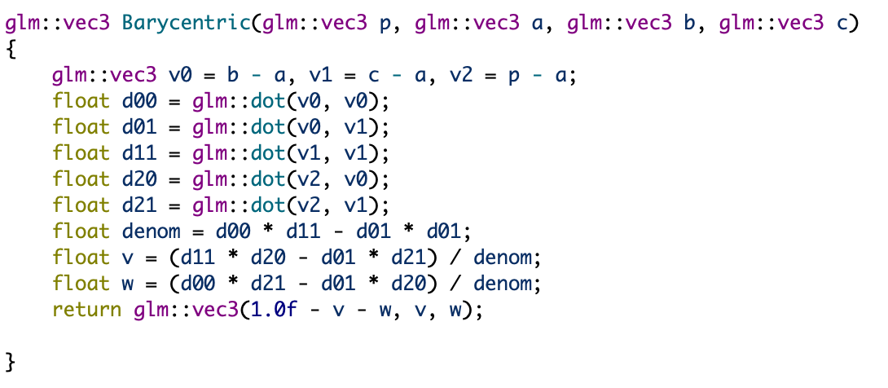
Extra Details
The following code calculates the barycentric coordinates of point p for a triangle with vertices a, b, and c

Slide 90
Extra Details
We can test collisions between a convex shape and a triangle!
The support function of a triangle is just the vertex of the triangle farthest in the direction of the input vector!

Slide 91
Hooray!
Now we have everything we need to implement basic rigid body physics for arbitrary convex shapes!

Slide 92
Class 4
Rigid Body Physics: Modeling the System

Slide 93
Rigid Body Physics
When we simulate physics on a computer, we represent the system we are simulating with a state vector
Given this state vector and the forces acting on the system, we can calculate the derivative of the state vector and use Euler’s method to propagate the system through time (i.e. next_state = old_state + derivative * dt)
Keep in mind that there are other ways to implement the basics of rigid body physics
This presentation is demonstrating a method based on David Baraff’s An Introduction to Physically Based Modeling

Slide 94
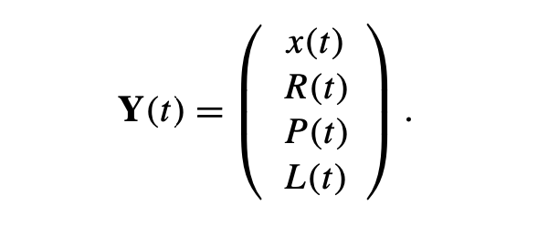
State Vector
Here is our state vector for a single rigid body
x(t) is the world space position of the object’s center of gravity
R(t) is the 3x3 rotation matrix that transforms the rigid body from object space to world space (we will call this the orientation matrix)
P(t) is the object’s linear momentum (which is a vector)
L(t) is the object’s angular momentum (which is a vector)

Slide 95
Rotations
We need to discuss the physics of rotations a bit

Slide 96
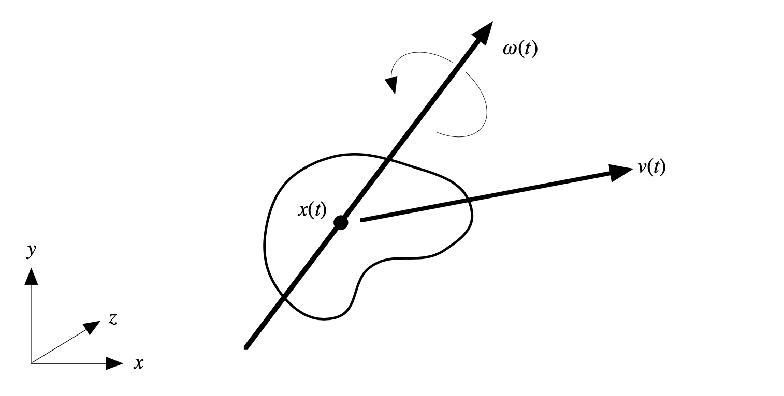

Angular Velocity
Angular velocity $ω$ is a vector whose direction describes the axis around which an object rotates, and whose magnitude describes how fast the object is rotating

Slide 97
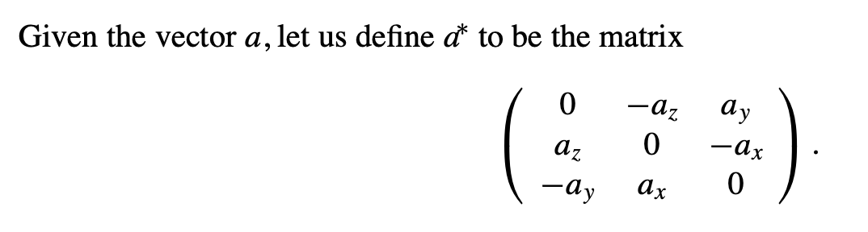
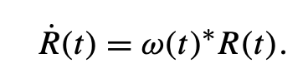
Angular Velocity
We can use the angular velocity of an object to calculate the derivative the of the orientation matrix R

Slide 98
Torque
If a force is exerted on an object that causes the rotation of that object to change, then we say that a torque is exerted on the object
Consider the blue bar secured to the red hinge below

Slide 99
Torque
If a force is exerted on an object that causes the rotation of that object to change, then we say that a torque is exerted on the object
Consider the blue bar secured to the red hinge below
This green force exerts a torque on the bar

Slide 100
Torque
If a force is exerted on an object that causes the rotation of that object to change, then we say that a torque is exerted on the object
Consider the blue bar secured to the red hinge below
This purple force exerts a smaller torque on the bar, even though it is equal in magnitude to the green force

Slide 101
Torque
If a force is exerted on an object that causes the rotation of that object to change, then we say that a torque is exerted on the object
Consider the blue bar secured to the red hinge below
This orange force exerts no torque on the bar

Slide 102
Torque
If a force is exerted on an object that causes the rotation of that object to change, then we say that a torque is exerted on the object
Consider the blue bar secured to the red hinge below
This orange force exerts no torque on the bar

Slide 103
Angular Momentum
Angular momentum is harder to understand than linear momentum
You can think about it as a vector quantity describing how an object is rotating, and how difficult it is to stop the object from rotating
Torque is the derivative of angular momentum

Slide 104
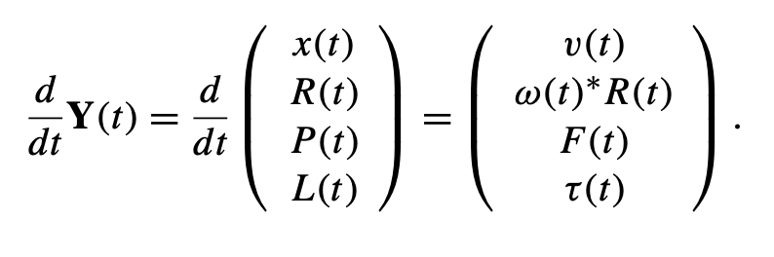

State Vector Derivative
Here is our state vector for a single rigid body
v(t) is the linear velocity
$ω\left(t\right)∗R(t)$is the derivative of the orientation matrix, as mentioned before
F(t) is the force acting on the object
$τ\left(t\right)$ is the torque acting on the object

Slide 105
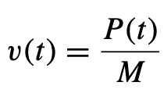
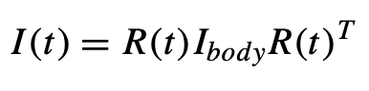
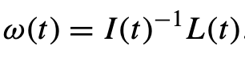

State Vector Derivative
We will pretend that the force and torque are given for now (you will probably only need to set the force to be gravity, and leave the torque alone)
Here are the formulas for calculating the angular momentum and the linear velocity:
Wait, what are $I(t)$ and $I_{body}$?

Slide 106
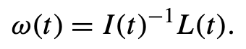

The Inertia Tensor
$I$ and $I_{body}$ are the inertia tensors in world space and object space, respectively
The inertia tensor is a 3x3 matrix
The inertia tensor is a generalization of the “moment of inertia”
$I$ relates the object’s angular velocity to its angular momentum, as shown below

Slide 107
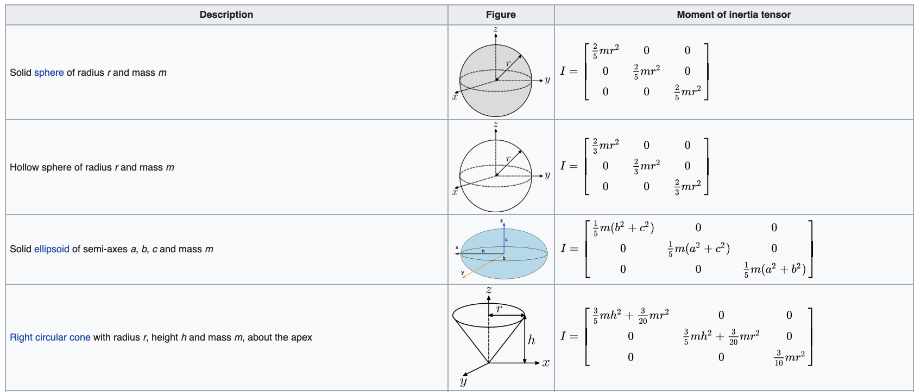
The Inertia Tensor
Here are inertia tensors in object space for different shapes

Slide 108
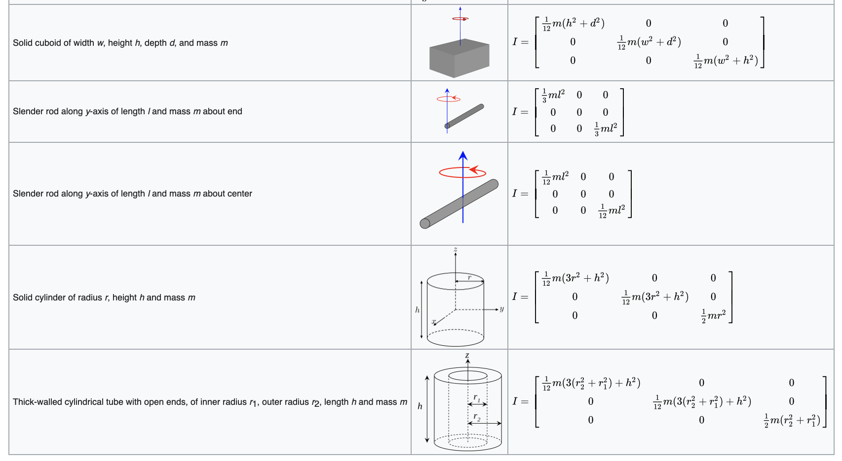
The Inertia Tensor
Here are inertia tensors in object space for different shapes

Slide 109
The Inertia Tensor
You can use these inertia tensors in object space along with your object’s orientation matrix to calculate the inertia tensor in world space

Slide 110
Euler’s Method
Now we know how to calculate the derivative of the state vector!
We can use Euler’s method to propagate the system through time
next_state = old_state + derivative * dt

Slide 111

Euler’s Method
Just one problem…
We need the orientation matrix to be a rotation matrix (i.e. its columns are unit vectors that are orthogonal to each other)
If we add $ω\left(t\right)∗R\left(t\right)⋅dt$ to the orientation matrix, we will not end up with a rotation matrix!
The easiest thing to do is to use the Gram-Schmidt process
This will turn the columns of $R\left(t\right)+ ω\left(t\right)∗R\left(t\right)⋅dt$ into a “close” orthonormal basis
There are better solutions to this problem

Slide 112
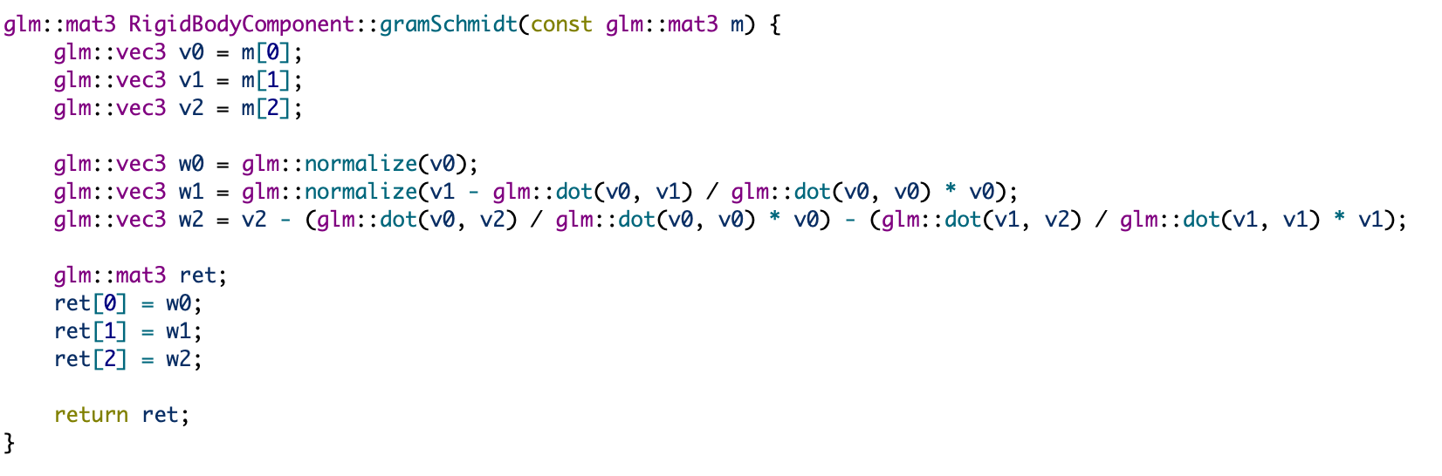
Gram-Schmidt Process
This code takes in a matrix (in column-major order) and returns a new matrix whose columns are the result of applying the Gram-Schmidt process to the columns of the original matrix

Slide 113
What Happened to Collisions?
We still haven’t discussed how we use the MTV and collision point to deal with collisions!

Slide 114
Class 4
Rigid Body Physics: Collision Response

Slide 115
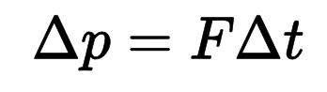
Impulse
Impulse is a change in momentum due to a force
It is equal to the force times the time interval over which it acts
When a collision happens, we will apply an impulse to the colliding objects

Slide 116
Impulse
Impulse is a change in momentum due to a force
It is equal to the force times the time interval over which it acts
When a collision happens, we will apply an impulse to the colliding objects using the mtv, the points of collision of the two objects, and those two points’ velocities
We can apply linear and rotational impulse
Once we have applied the impulse, we use Euler’s method again
For more info, check out An Introduction to Physically Based Modeling: Rigid Body Simulation II—Nonpenetration Constraints by David Baraff

Slide 117
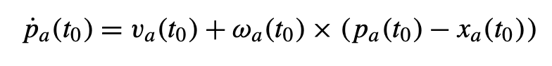

Calculating the Impulse
The velocity of the point on a rigid body is given by the formula below.
It is the sum of the linear velocity and angular velocity
${\dot{p}}_{a}(t)$ is the velocity of the point on the rigid body
$v_{a}(t)$ is the linear velocity of the rigid body
$ω_{a}(t)$ is the angular velocity of the rigid body
$p_{a}\left(t\right)$ is the position of the point on the rigid body in world space
$x_{a}(t)$ is the position of the center of gravity of the rigid body in world space

Slide 118


Calculating the Impulse
Let $m$ be the normalized mtv for the collision between objects A and B
Consider the quantity $v_{rel}=m⋅({\dot{p}}_{a}−{\dot{p}}_{b})$
The final impulse is equal to $v_{rel}=m⋅({\dot{p}}_{a}−{\dot{p}}_{b})$

Slide 119
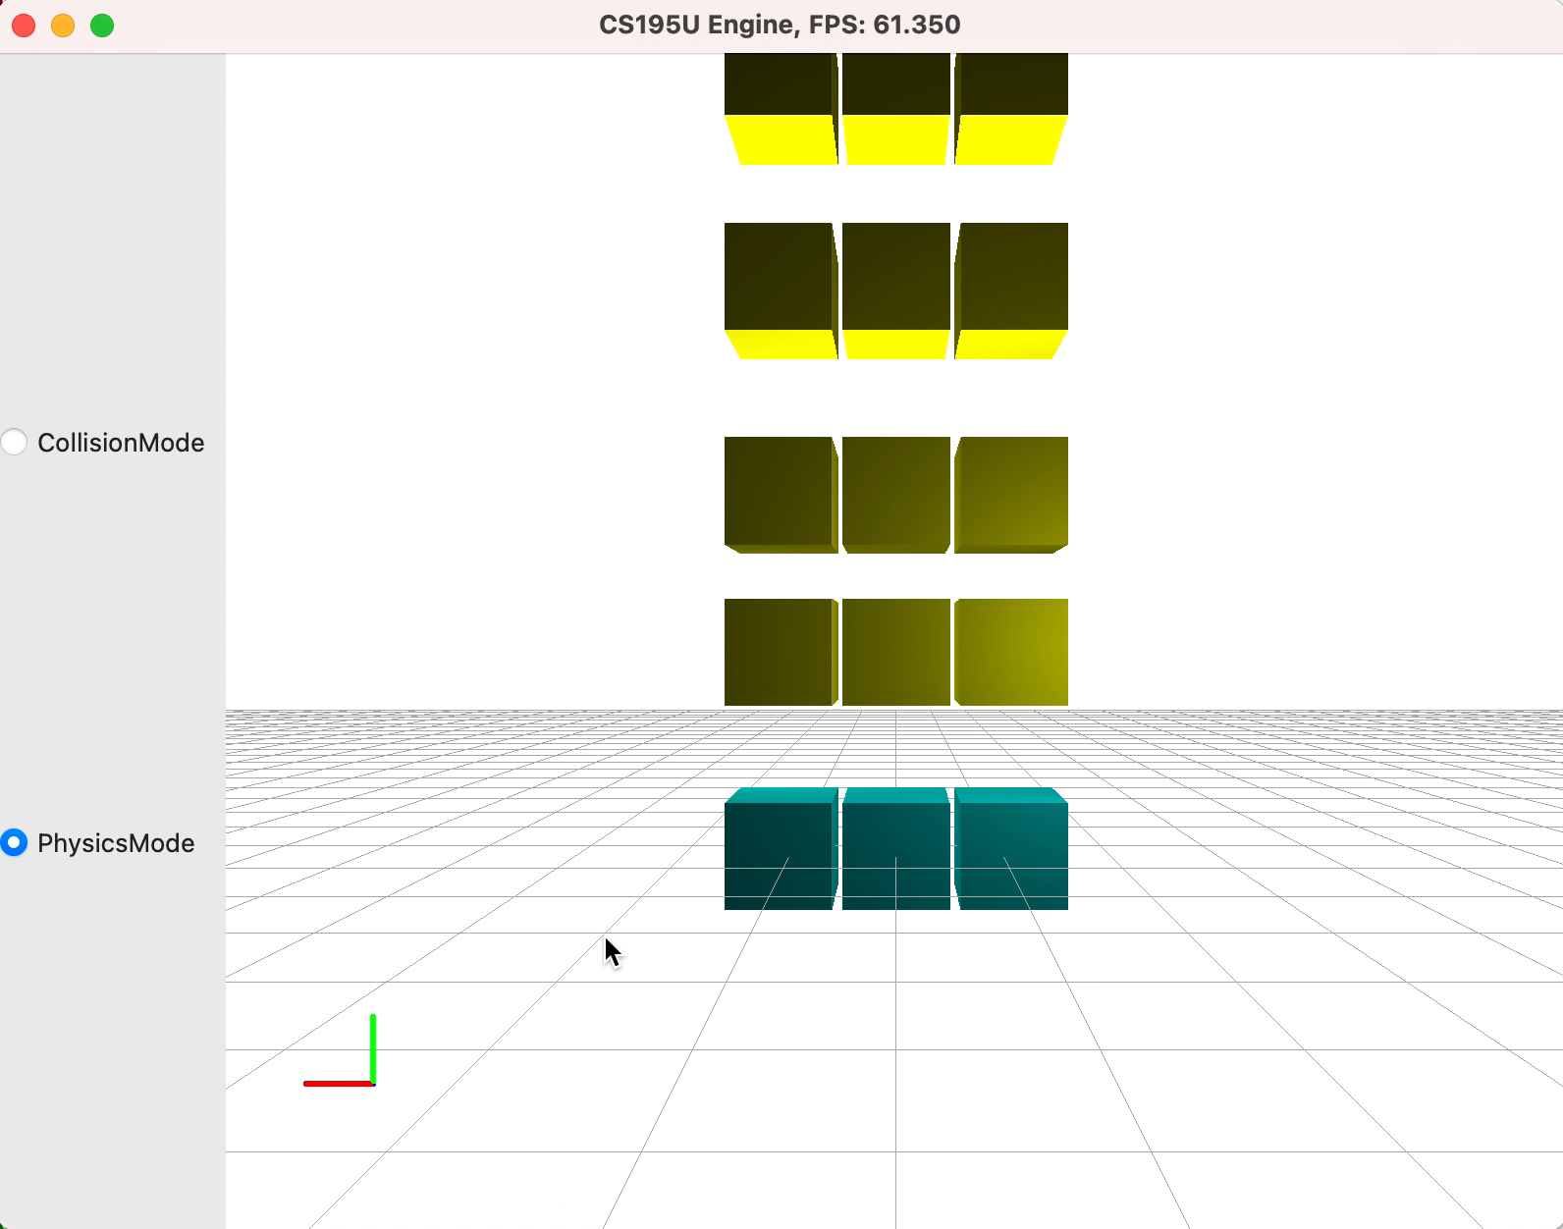
Finally!
We get collisions and rotational physics! Wow!
Notice that there is no friction here

Slide 120
Class 4
The GJK Debugger

Slide 121
The GJK Debugger
We have a debugging tool to help you implement the GJK algorithm!

Slide 122
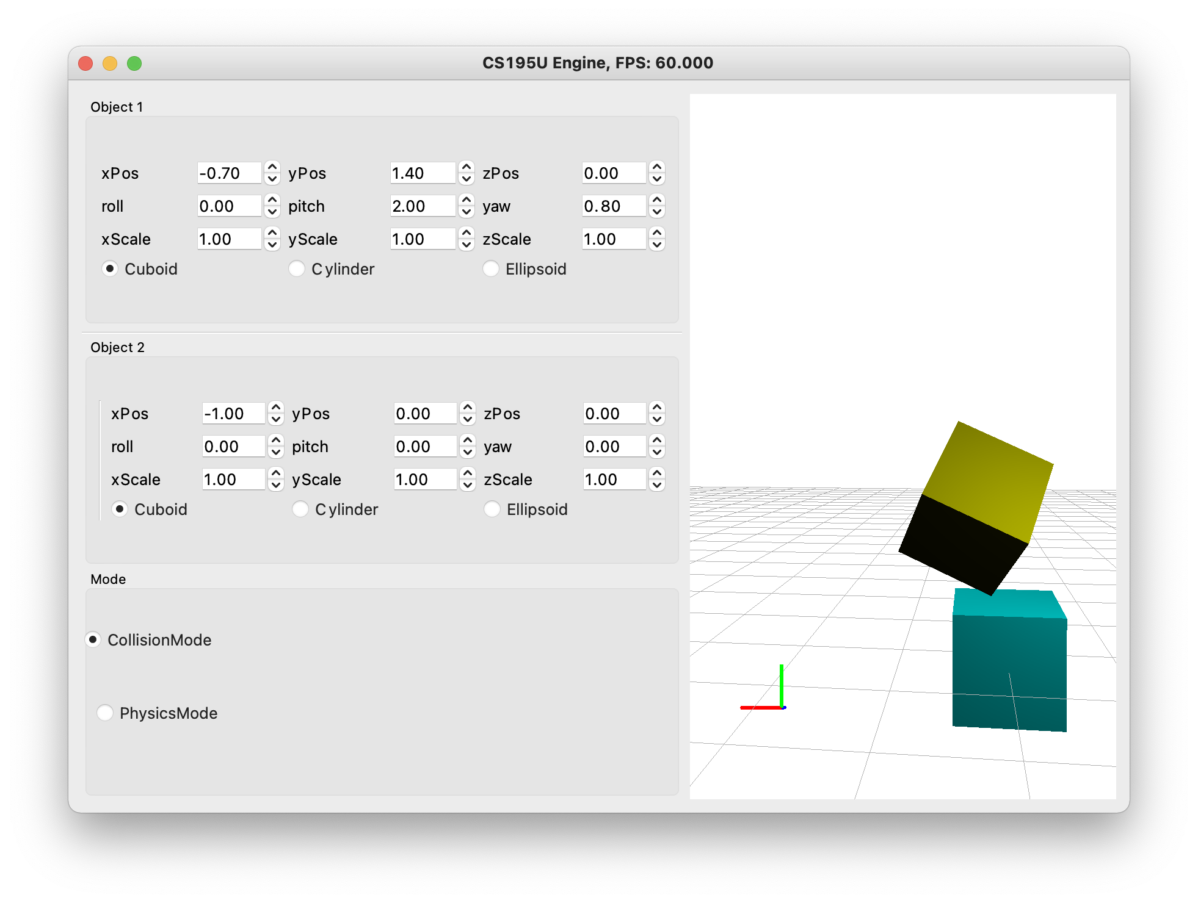
The GJK Debugger

Slide 123
Class 4
Advanced Collisions and Physics

